Slide 1
Capstone Project - The Battle of Neighborhoods (Week 2)

Slide 2
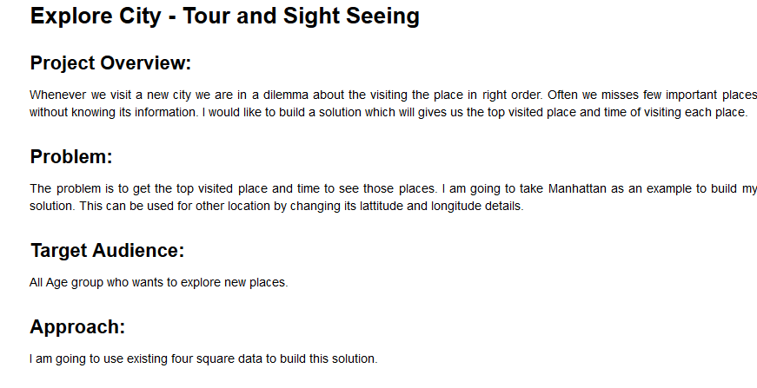

Slide 3
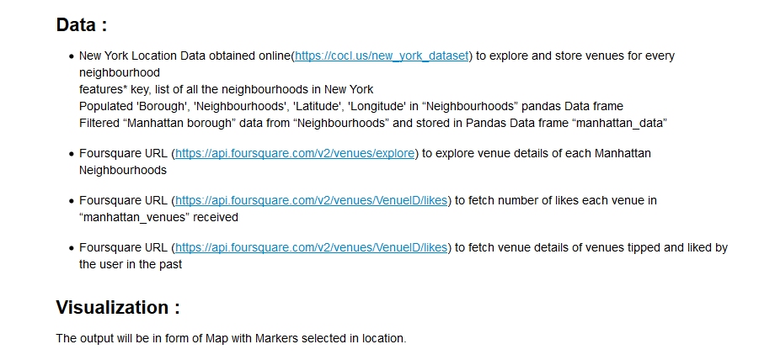

Slide 4
